Slide 1
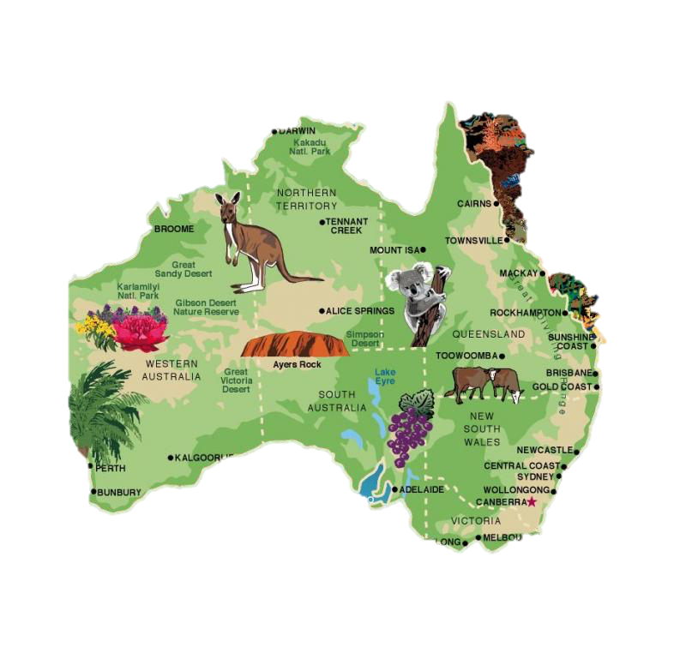
Work with GIS Australia Map
Rayanh Aloridh
Abeer Alghanem
Noura Alanzan

Slide 2
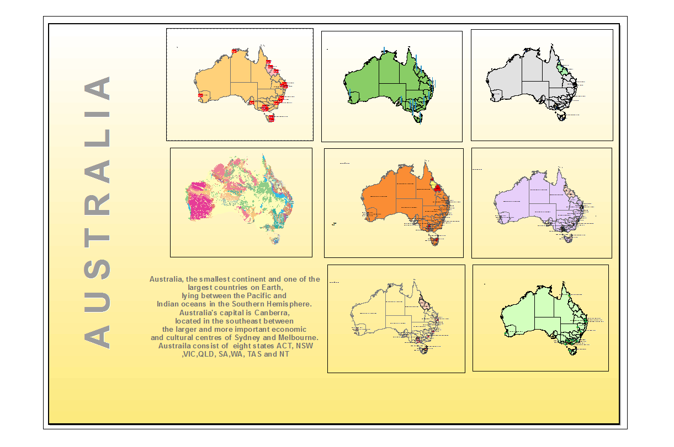
Poster of Australian Maps:
The poster contain the 8 maps that team member works on it. Australia has large area so, there’s a lot of thing to cover it. Starting form religion and forest ending to the terrain.

Slide 3
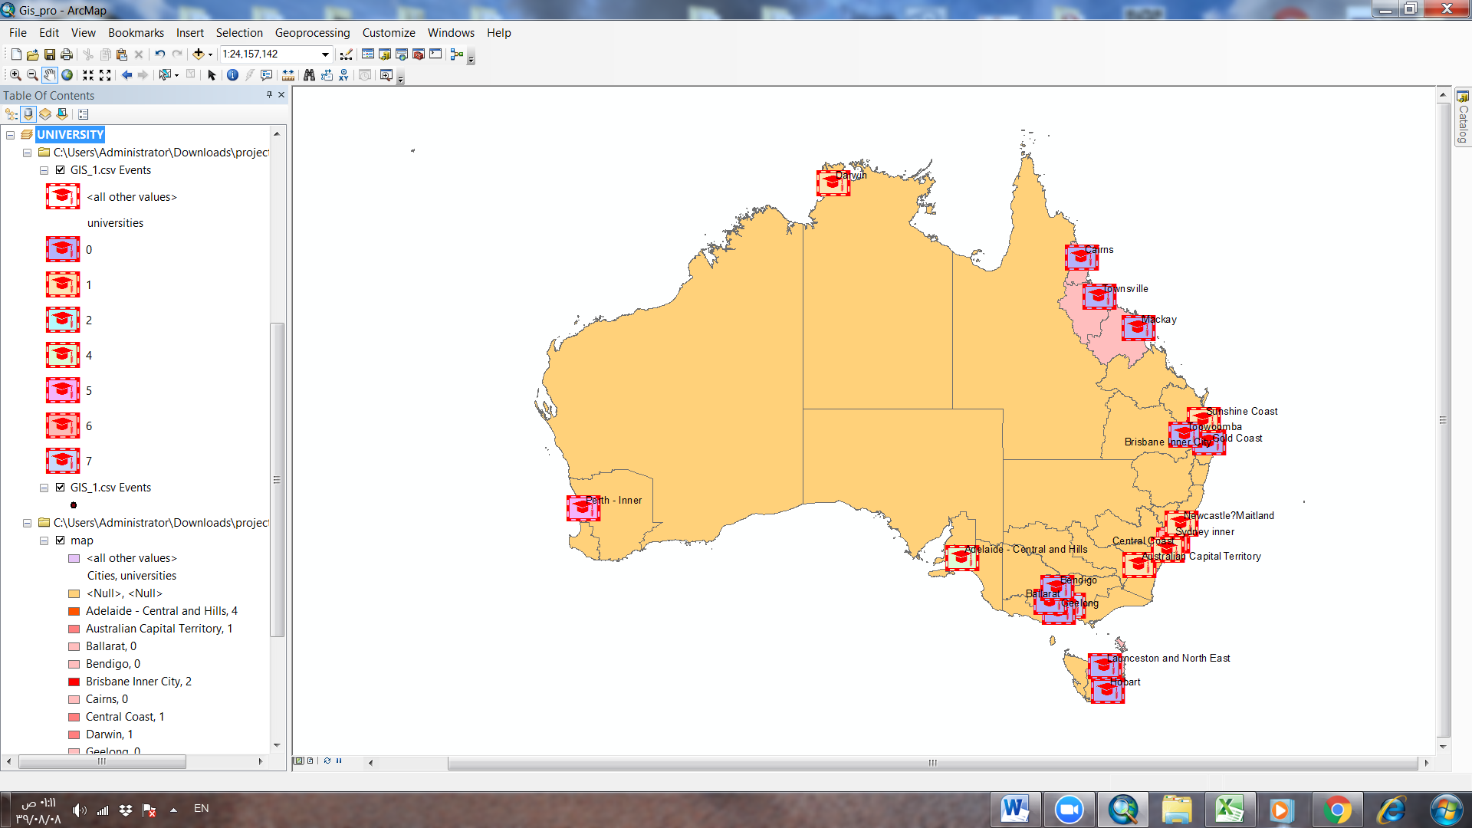
1/University and Cities Map :
From ARCMAP this map show the Australia region. The sympolgy is for university in the data area that has been collected from websites and recorded it in excel file with CSV extend. The Pink color shows the cities we recorded. We noticed the university distribute in the capital cities more than the small city by looking to the map.

Slide 4
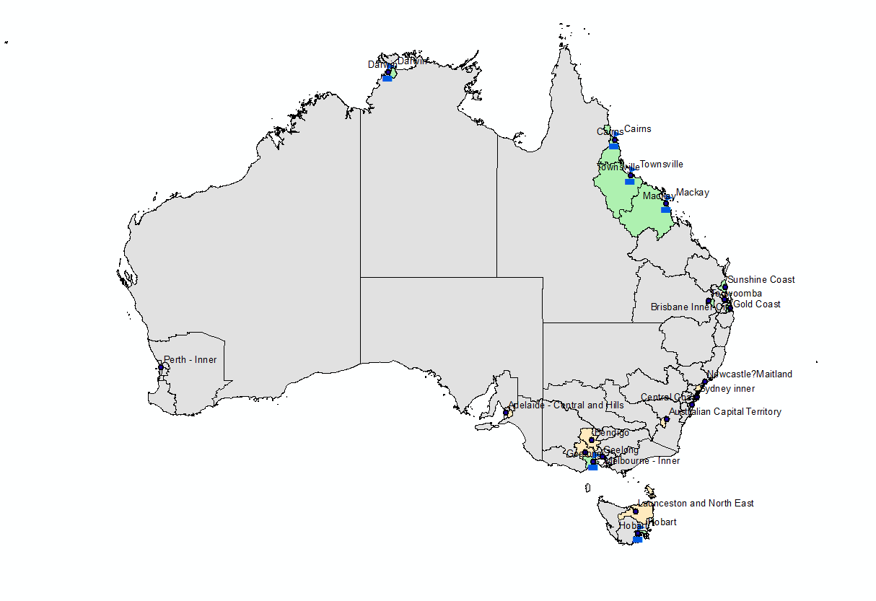
2/Ports and cities Map:
The ports is important for any country and it’s improve the economy for each city .We noticed that Australian cities have a lot of ports and it’s basic of supply each city. In the map show by green color the city have ports and the beige color show the cities who haven’t ports from our data that we collect. Also, the null value we chose grey color to represent it.

Slide 5
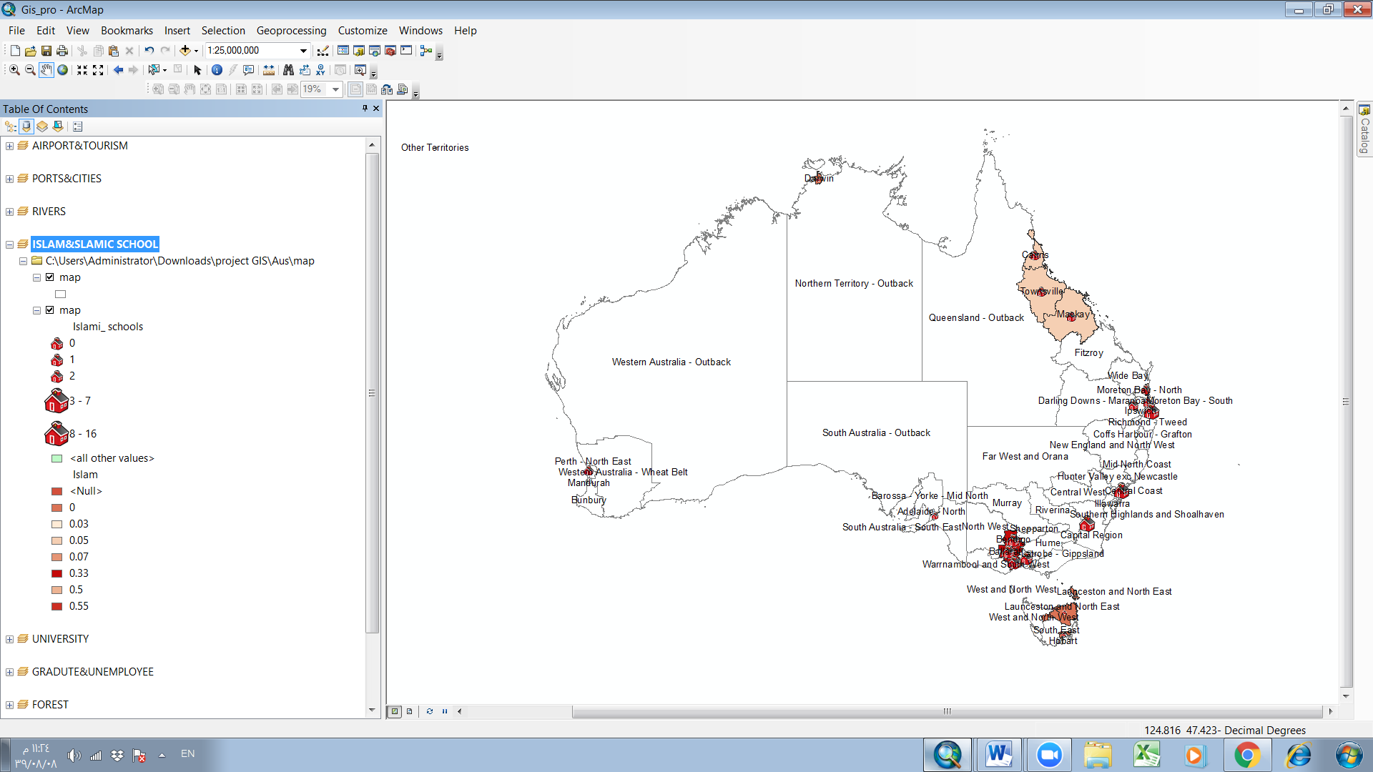
3/Islamic and Islamic School Map:
Map in this slide show the comparing between important attribute the numbers of Muslim people and who many Islamic school. The label show the names of cities from our data and the states. School symbology represent the Islamic school and the different color starting from light to the dark represent the numbers
of Muslim in each city.

Slide 6
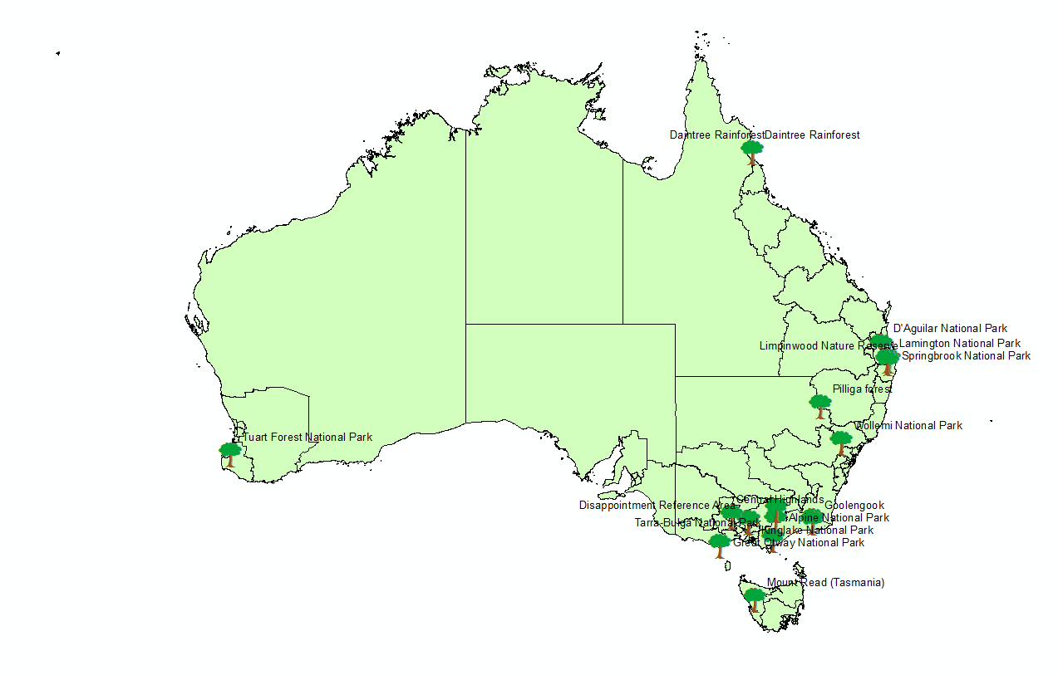
4/Forests Map:
The Forest map show the location of the forest with there names. We made new file to represent this information. Tree is the sympology that represent the location of forest by latitudes and longitudes.

Slide 7
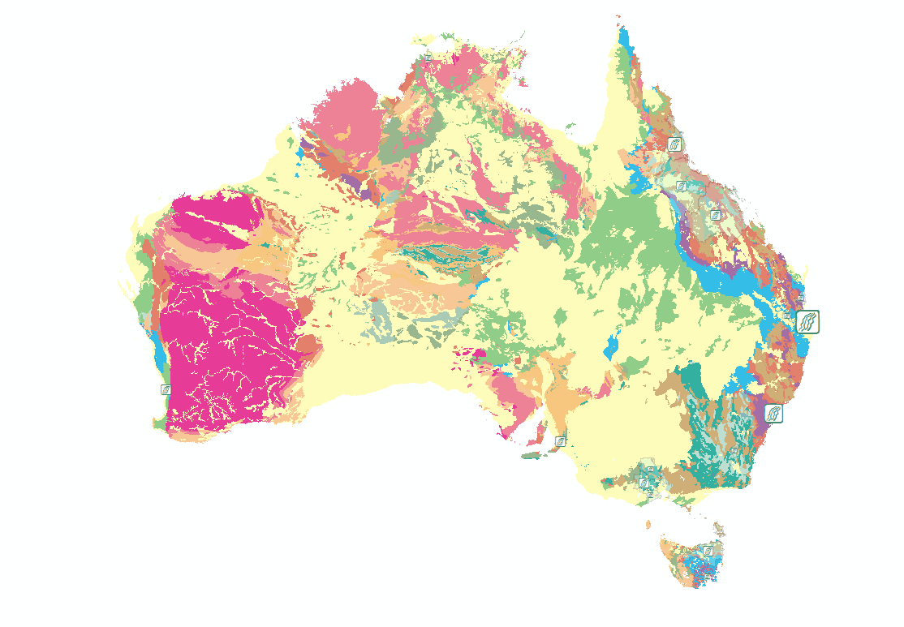
5/Rivers and Terrain
Australia popular by rivers and because it’s have large area that make the terrain different and multiple. Using ARCMAP to show the terrain by coloring them and comparing them by river.

Slide 8
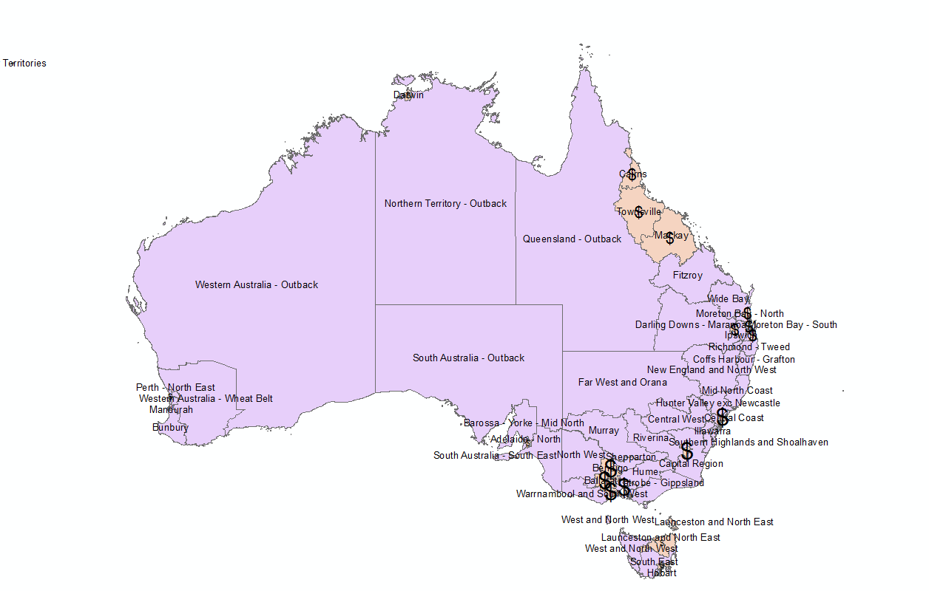
6/Economy and Statues
Australia have many states area and that gave it chance to have many kind of resource who growth the economy that showing in this map. Represent by dollar sign to make different from the usual.

Slide 9
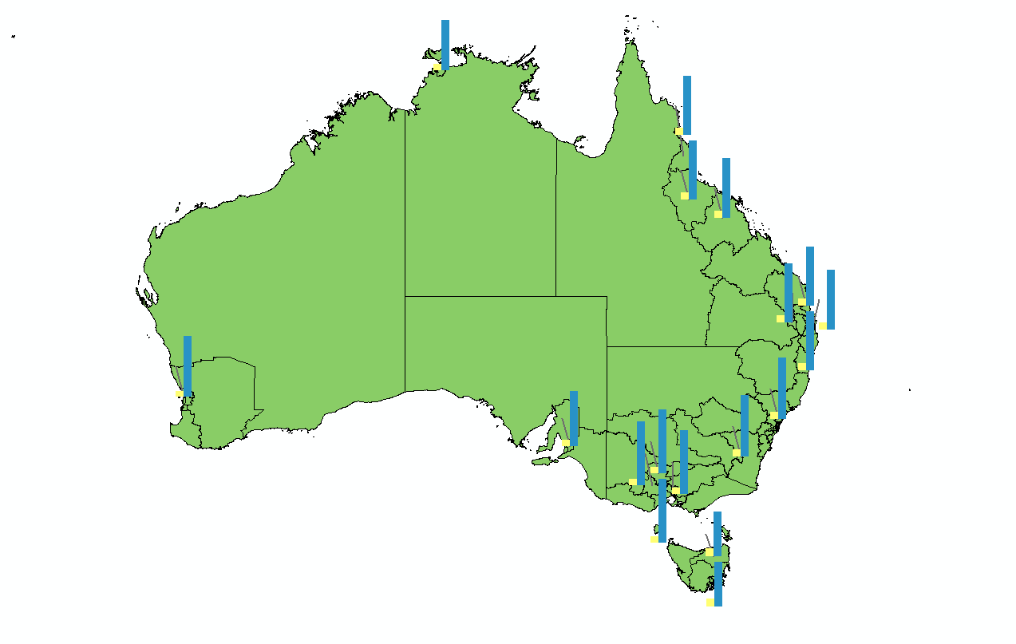
7/Graduate and unemployee map:
The chart from ARCMAP show the student who graduate from school by blue color and yellow show the the student who graduate and still unemployed. From the we can noticed that the percentage of the unemployed people few comparing with the number of student who graduate.

Slide 10
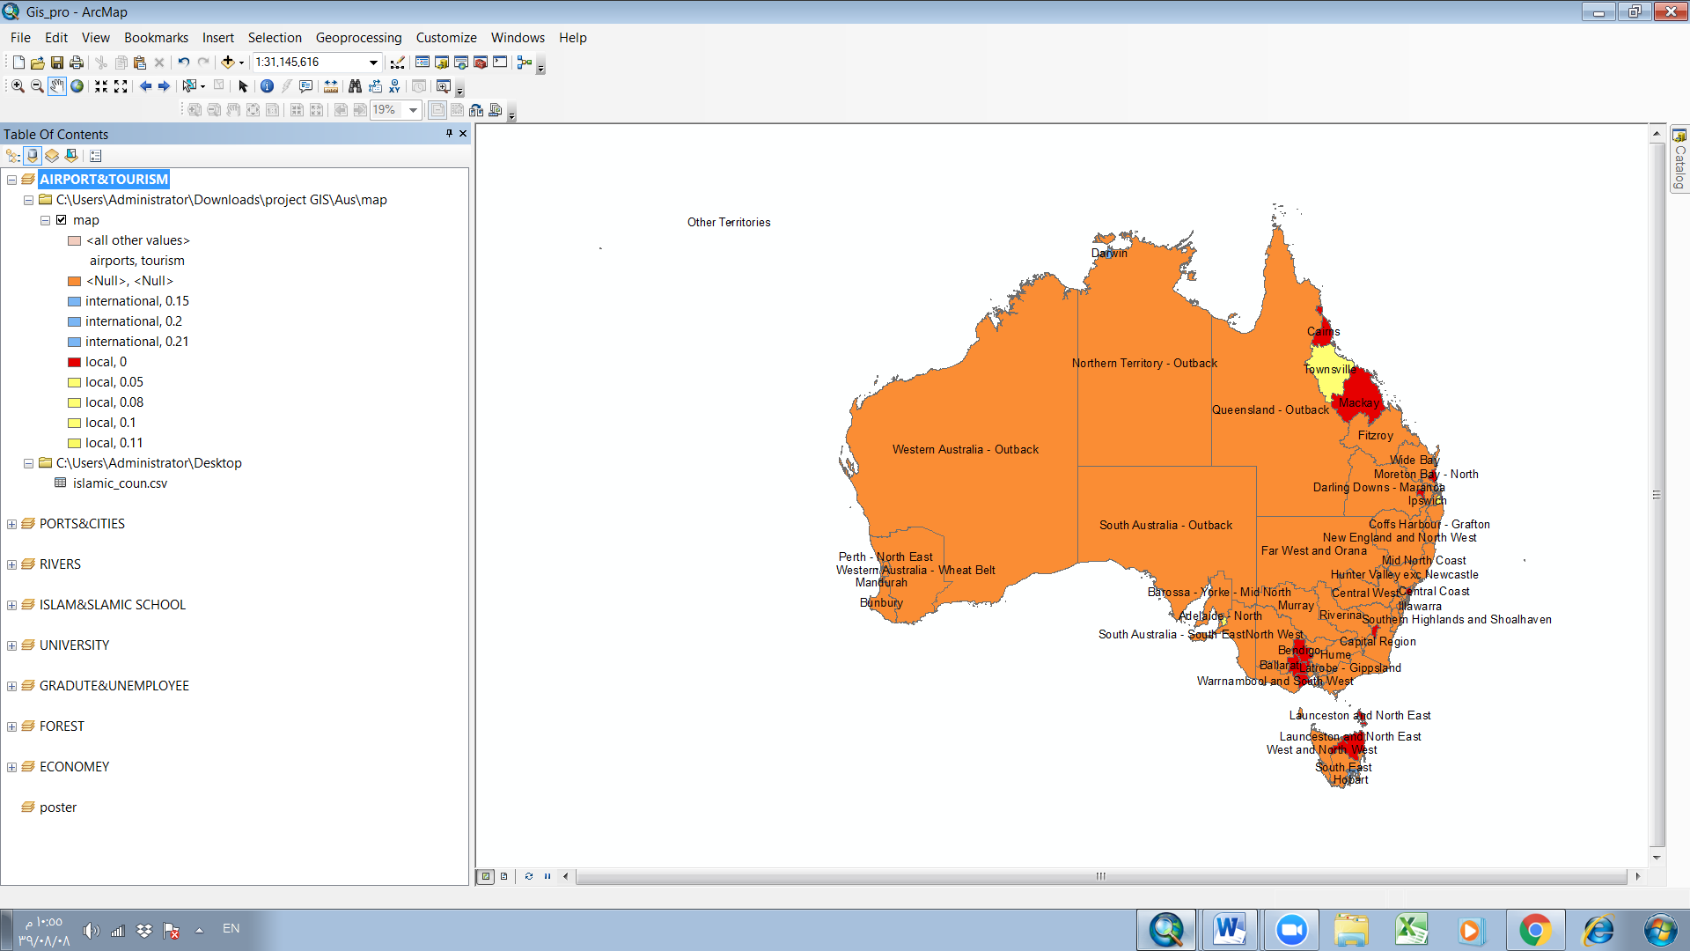
Airport and tourism map:
The map show the number of airport as we mission before that Australia have large area and we comparing it with numbers of tourism. Activing the cities who has airport.

Slide 11
Conclusion:
In the end, the group made 8 maps with symbologys and different sight of Australia from searching the map and the latitude , longtitude and the data they collect and join it with the table in the Australia map. Eights Map shows some of them comparing two attribute and some of them have strong attribute and stand alone. The ArcMap the main component of Esri ArcGIS suite of geospatial processing programs and it used to edit, view, create and analyze geospatial data.

